Slide 1
Web Programming
Node - CRUD - Files
Lecture 23
Mahhek Khan
Notes:
.

Slide 2
NODE.js
Node.js is a JavaScript runtime built on Chrome's V8 engine.
Allows you to run JavaScript on the server.
Non-blocking, event-driven architecture – great for web apps & APIs.

Slide 3
Express.js
Definition: Express is a minimal and flexible Node.js web application framework.
Purpose: Simplifies routing, handling HTTP requests, middleware.

Slide 4
Setup Node
Install Node.js: Go to nodejs.org and install the latest version.
Verify Installation: Open terminal and run:
node -v
npm -v

Slide 5
Setup a Project
# 1. Create a folder
mkdir my-node-app
cd my-node-app
# 2. Initialize Node.js
npm init -y
# 3. Install mongoose and express
npm install express mongoose cors dotenv
npm install --save-dev nodemon
mkdir config controllers models routes
# 4. Create main file
touch index.js .env
npm run dev

Slide 6
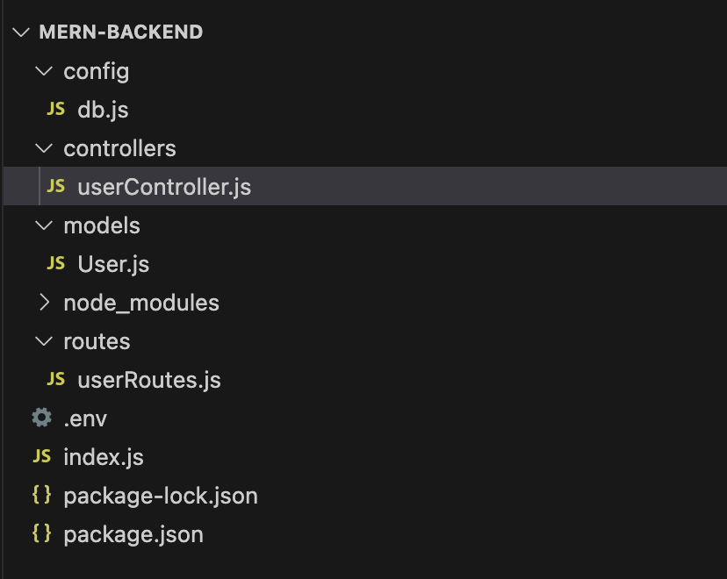
File Structure

Slide 7
.env
PORT=5000
MONGO_URI=mongodb://localhost:27017/mernapp

Slide 8
MongoDB connection (config/db.js)
const mongoose = require('mongoose');
const connectDB = async () => {
try {
await mongoose.connect(process.env.MONGO_URI);
console.log('MongoDB connected');
} catch (err) {
console.error(err.message);
process.exit(1);
}
};
module.exports = connectDB;

Slide 9
models/User.js
const mongoose = require('mongoose');
const userSchema = new mongoose.Schema({
name: { type: String, required: true },
email: { type: String, required: true, unique: true }
}, { timestamps: true });
module.exports = mongoose.model('User', userSchema);

Slide 10
routes/userRoutes.js
const express = require('express');
const router = express.Router();
const { getUsers, createUser } = require('../controllers/userController');
router.get('/', getUsers);
router.post('/', createUser);
module.exports = router;

Slide 11
controllers/userController.js
const User = require('../models/User');
exports.getUsers = async (req, res) => {
const users = await User.find();
res.json(users);
};
exports.createUser = async (req, res) => {
const user = new User(req.body);
await user.save();
res.status(201).json(user);
};

Slide 12
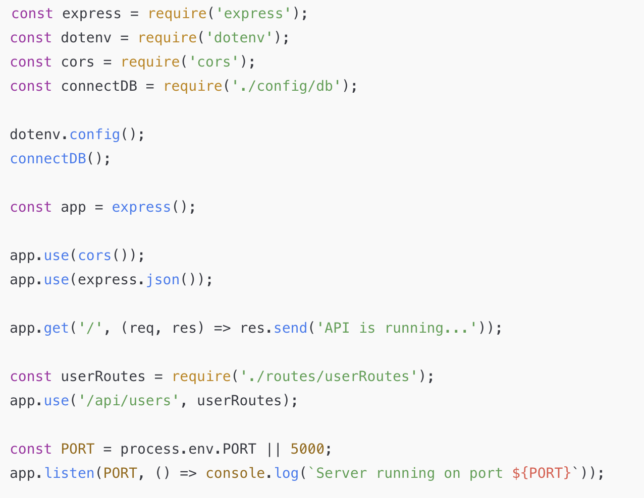
index.js

Slide 13
Middleware
The use function in app, i.e., app.use() is used to call middleware functions.
Middleware are functions that intercept an incoming request before the request can be handled by the concerned route handler (controller).
In the previous code, app.use(express.json()), express.json() is middleware that intercepts the incoming request and parses the json body/payload if it exists and puts the parsed json body in req.body as JS object.

Slide 14
run server
package.json:
"scripts": {
"start": "node index.js",
"dev": "nodemon index.js"
}
npm run dev
http://localhost:5000

Slide 15
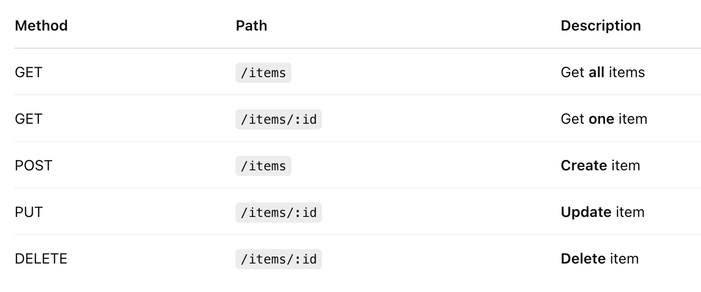
Rest Routes

Slide 16
Example items

Slide 17
Pass Parameter as body to api
#1: Client-side (React, etc.): You send a request like: (Create)
POST /items
Content-Type: application/json
{
"name": "Notebook",
"quantity": 10
}
#2: Server-side (Node.js with Express): The server receives the request.
const { name, quantity } = req.body;
This line extracts name and quantity from the request body.
#3: Passing to Model
Then, Mongoose uses these values to create a new document:
const newItem = new Item({ name, quantity });
await newItem.save();

Slide 18
Pass Parameter as body to api
#1: Client-side (React, etc.): You send a request like: (Update)
PATCH /items/12345678
Content-Type: application/json
{
"name": "Updated Item",
"quantity": 20
}
#2: Server-side (Node.js with Express): The server receives the request.
const { name, quantity } = req.body;
#3: Passing to Model
const item = await Item.findByIdAndUpdate(
req.params.id, // The item ID passed in the URL
{ name, quantity }, // The data passed in the body of the request
{ new: true, runValidators: true }
);

